Slide 1

KIET Group of Institutions, Ghaziabad
(An ISO – 9001: 2008 Certified ‘A+’ Grade accredited Institution by NAAC)
DEPARTMENT OF COMPUTER SCIENCE
Project Presentation (KCS 851)
PENTACKLES
Guide Name: Mr. Vivek Kumar Sharma
Project Members
1.Aakansha Tyagi (2000290120001)(Sec-A)
2.Aakriti Gupta (2000290120002) (Sec-A)
3.Ayush Jaiswal (2000290120052) (Sec-A)
4.Ayush Tyagi (2000290120056) (Sec-A)

Slide 2
Problem Statement
Is to develop a machine learning-based system to predict the risk of heart disease in individuals based on their medical history and clinical data. This system should be easy to use and provide quick predictions to aid healthcare professionals in identifying at-risk patients and making informed decisions about their care.

Slide 3
Objectives
The system we have proposed is user friendly which helps the user immediately without any time delay. This system is used to predict Heart disease .
This project includes a website which will predict the possibility of heart diseases based on the data provided by the user .
The main motive of the proposed system is the prediction of the heart diseases in the early phase as when it is not checked .

Slide 4
Technology Used
FRONTEND
Hypertext Markup language(HTML)
Cascading Style Sheet(CSS)
JavaScript(JS)
Bootstrap
BACKEND
FLASK
Python(Numpy, Pandas, Seaborn, Matplotlib)
Machine Learning
Support Vector Machine(SVM)
Random Forest
Logistic Regression
K Nearest Neighbors(KNN)

Slide 5
Literature Survey-1
Title: A Hybrid Cauchy Crazy Particle Swarm Optimization Support Vector Machine Algorithm for Heart disease prediction
Author: Mandakini Priyadarshani Behera et al.
Journal Name: Procedia Computer Science
Year of Publishing: 2022
Summary-
Provided an algorithm for heart and liver disease prediction, as well as heart and liver datasets. SVM, PSOSVM, CPSOSVM, and CCPSOSVM are four algorithms used to predict heart and liver disease. The performance of each method has been calculated and assessed in terms of the confusion matrix, classification accuracy, classification error rate, precision, recall, and F1 score.
The heart disease dataset was collected from the University of California, Irvine (UCI), machine learning repository. The heart dataset has 13 attributes and 270 instances, the dataset for liver disease is retrieved from the UCI machine learning repository and the dataset has 10 attributes and 583 instances.
The study concludes from rigorous experimental investigation that designed CCPSOSVM gives excellent classification results, with the highest classification rate and lowest error rate for heart and liver sickness prediction.

Slide 6
Literature Survey-2
Title: Machine Learning Model Prediction of Mortality in Patients With and Without Heart Failure
Authors: Se Yong Jang et al.
Journal Name: JACC: Advances
Year of Publishing: September 2023
Summary:
Predicting mortality risk is vital for tailoring medical care to patients, allowing for appropriate monitoring, therapy referral, and end-of-life counseling. Existing risk prediction models tend to be disease-specific, limiting their applicability across different medical conditions. The MARKER-HF model aims to overcome this limitation by providing a reliable indicator of mortality risk across various diseases.
The result of this study shows that the average age of the 41,749 patients was 65, with 56.2% being male.
MARKER-HF accurately predicted mortality in subgroups with and without cardiovascular disease, as well as in patients with acute coronary syndrome, atrial fibrillation, chronic obstructive pulmonary disease, chronic kidney disease, diabetes mellitus, or hypertension. . The study concludes that MARKER-HF predicts mortality for patients with HF as well as for patients suffering from a variety of diseases.

Slide 7
Literature Survey-3
Title: A Novel Machine Learning Model with Stacking Ensemble Learner for Predicting Emergency Readmission of Heart-Disease Patients
Author: Alireza Ghasemieh, Alston Lloyed, Parsa Bahrami, Pooyan Vajar, Rasha Kashef
Journal Name: Decision Analytics Journal
Year of published:2023
Summary-
Cardiovascular diseases are a leading cause of mortality worldwide, emphasizing the need for early detection and intervention. Existing machine learning approaches for heart disease detection have limitations, resulting in misdiagnoses and overcrowded medical facilities. This study introduces a novel model for identifying patients at risk of emergency readmission, utilizing behavior-based features to create a new class label for emergency readmission.
The proposed model employs a robust Stacking Ensemble Learner (SEL) using ensemble learning, with XGBoost as the meta-learner. The model predicts whether a patient with heart problems requires emergency admission after an initial admission.
The study acknowledges the potential limitation of the dataset size, which might affect the generalizability of the model.

Slide 8
Literature Survey-4
Title-Using a machine learning-based risk prediction model to analyze the coronary artery calcification score and predict coronary heart disease and risk assessment
Author -Yue Huang a,1 , YingBo Ren a,1 , Hai Yang a , YiJie Ding b , Yan Liu a , YunChun Yang a , AnQiong Mao a , Tan Yang d , YingZi Wang c , Feng Xiao c , QiZhou He e, Ying Zhang a
Journal Name-Computers in Biology and Medicine
Year of publishing-2022
Summary-
Cardiovascular disease, particularly coronary heart disease (CHD), is a leading cause of death worldwide. The study aims to evaluate the use of ML models to predict CHD risk more accurately.
Conditions such as hypertension, diabetes, fatty liver, osteoporosis, and hyperlipidemia were considered. Various ML models were selected for prediction, including Random Forest (RF), k-nearest neighbor(KNN), support vector machines (SVM), Kernel Ridge Regression (KRR), and radial basis function neural networks (RBFNN). Performance evaluation of the models included metrics such as accuracy, sensitivity, specificity, and the Matthews correlation coefficient (MCC).
RF was found to have the best predictive performance in terms of accuracy, sensitivity, specificity, MCC, and AUC compared to other ML models.

Slide 9
Literature Survey-5
Title-Development of smart cardiovascular measurement system using feature selection and machine learning models for prediction of sleep deprivation, cold hands and feet, and Shanghuo syndrome
Author Name- Chun-Ling Lin a, Chin-kun Tseng b, Chien-Jen Wang b, Shu-Hung Chao b, Yuh-Shyan Hwang b, Lih-Jen Kau b
Journal Name- International Measurement Confederation
Year of publishing-2023
Summary-
It introduces the concept of a smart cardiovascular measurement system that utilizes ECG and PPG to evaluate sleep deprivation, cold hands and feet, and Shanghuo syndrome (from Traditional Chinese Medicine) and discusses the goals of the study
The study involved 83 healthy adults, including 26 males and 57 females. Features were extracted from both ECG and PPG signals. A total of 38 features were selected, including 19 from ECG and 19 from PPG. Various machine learning methods were explored, including ensemble learning, kernel classification, k-nearest neighbor, support vector machine, naive Bayes, neural network, and decision tree classifiers. Bayesian optimization was used to fine-tune model selection and hyperparameter values. Model performance was measured using accuracy, computed using true positives, true negatives, false positives, and false negatives.
The study acknowledges limitations, including a relatively small sample size and the potential influence of additional factors not considered.

Slide 10
Literature Survey-6
Title: Machine Learning Approach for Risk Factors Analysis and Survival Prediction of Heart Failure Patients
Authors: Md. Mamun Ali a , Vian S. Al-Doori b , Nubogh Mirzah c , Asifa Afsari Hemu d , Imran Mahmud a , Sami Azam e , Kusay Faisal Al-tabatabaie f , Kawsar Ahmed g,h,∗ , Francis M. Bui g , Mohammad Ali Moni
Journal Name: Healthcare Analytics
Published Year:2023
Summary:
Cardiovascular diseases, including HF, are a major global health concern. This study focuses on HF, a condition where the heart struggles to pump enough blood. The research aims to analyze risk factors and predict survival in HF patients using machine learning methods.
The study employs a dataset with 299 instances, including 96 deaths and 203 survivors. Data preprocessing involves handling missing values, feature engineering, and balancing the dataset.
Five ML algorithms are applied, including Decision Tree, Random Forest, XGBoost, and Gradient Boosting, to train and test the models. Performance metrics (accuracy, precision, recall, F-measure, log loss) are employed for evaluation. RF shows maximum accuracy in this model.

Slide 11
Literature Survey-7
Title: Machine Learning-Based Predictive Models for Heart Disease Diagnosis
Author Name: Stojanov, Lazarova, Veljkova, Rubartelli, Giacomini
Journal Name: King Saud University
Year of Publishing: 2023
Summary:
This study explores the use of machine learning techniques to predict heart disease based on various health-related attributes. Feature selection is employed to identify relevant features, and ten different machine learning algorithms are analyzed. The Decision Tree algorithm stands out with the highest accuracy .
This study leverages logistic regression as a core model to predict heart failure against chronic-ischemic heart disease in the elderly population. By analyzing biochemical variables, a subset of variables is identified as excellent for discriminating between heart failure and chronic-ischemic heart disease.
The study highlights the predictive potential of individual biochemical parameters. While the study faced limitations due to a small sample size, it offers the groundwork for the development of precise diagnostic software, which can be enhanced with more patient data.

Slide 12
Literature Survey-8
Title: Heart Diseases Prediction based on Stacking Classifiers Model
Author: Subasish Mohapatra, Sushree Maneesha, Prashanta Kumar Patra, Subhadarshini Mohanty
Journal Name: International Conference on Machine Learning and Data Engineering
Year of Publishing: 2023
Summary:
The introduction highlights the importance of machine learning in various domains, including healthcare. It emphasizes the need for efficient analysis of the growing volume of medical data generated by digital systems.
Cardiovascular diseases are a significant global health concern, and early detection is crucial for effective treatment. Traditional diagnostic methods are slow and costly, motivating the adoption of machine learning for faster and more accurate diagnoses.
The methods section outlines the workflow, data preprocessing steps and the stacking approach used for model building. The stacking involves two levels: base learners and meta-learners. The goal is to harness the strengths of diverse classifiers to improve prediction accuracy.

Slide 13
Literature Survey-9
Title: Automating Cardiovascular Disease Prediction Using Machine Learning and EMR Data
Authors: Qi Li, Alina Campan, Ai Ren, Wael E. Eid
Journal: International Journal of Medical Informatics
Year of Publishing: 2022
Summary:
Cardiovascular disease is a significant health concern globally, with varying prevalence and mortality rates in different regions. Accurate risk assessment is crucial for effective prevention and intervention strategies. Current risk assessment tools like the PCE Risk Calculator may not provide precise risk estimates for all populations. This study aims to develop an automated CVD risk calculator tailored to a specific population using machine learning and EMR data.
The authors collected EMR data from over 100,000 patients from a regional healthcare system, spanning from January 1, 2009, to April 30, 2020. Machine learning techniques were applied to these datasets, considering both cross-sectional (CS) features and a combination of CS and longitudinal (LT) features derived from vital statistics and laboratory values. The study evaluates the performance of various machine learning models and compares them to the PCE Risk Calculator.
All machine learning models tested outperformed the PCE Risk Calculator in predicting CVD risk. The random forest machine learning technique applied to the combination of CS and LT features achieved the highest accuracy.

Slide 14
Literature Survey-10
Title: Machine Learning-Based Approach to the Diagnosis of Cardiovascular Disease Using a Combined Dataset
Author Names: Khandaker Mohammad Mohi Uddin, Rokaiya Ripa, Nilufar Yeasmin, Nitish Biswas, Samrat Kumar Dey
Journal Name: Intelligence-Based Medicine
Year of Publishing: 2023
Summary:
Heart disease is one of the most serious ailments, killing the majority of its victims. Heart disease is very difficult to diagnose medically. Early identification of heart disease will reduce the risk of mortality. Predicting heart illness has grown to be one of the most challenging medical tasks in recent years due to the prevalence of cardiac issues.
In this work, the existence of cardiac anomalies is detected using Machine Learning (ML) approaches. Several machine learning (ML) algorithm techniques, including Decision Tree (DT), Ada-Boost Classifier (AB), Extra Trees Classifier (ET), Support Vector Machine (SVM), Gradient boost, MLP, extreme gradient boost (XGB), Random Forest (RF), KNN, and LR, are used in the proposed method to predict the likelihood of heart disease and classify the risk level of the patient.
The testing findings demonstrate that the Decision Tree method has the best accuracy, when compared to other machine learning techniques.

Slide 15
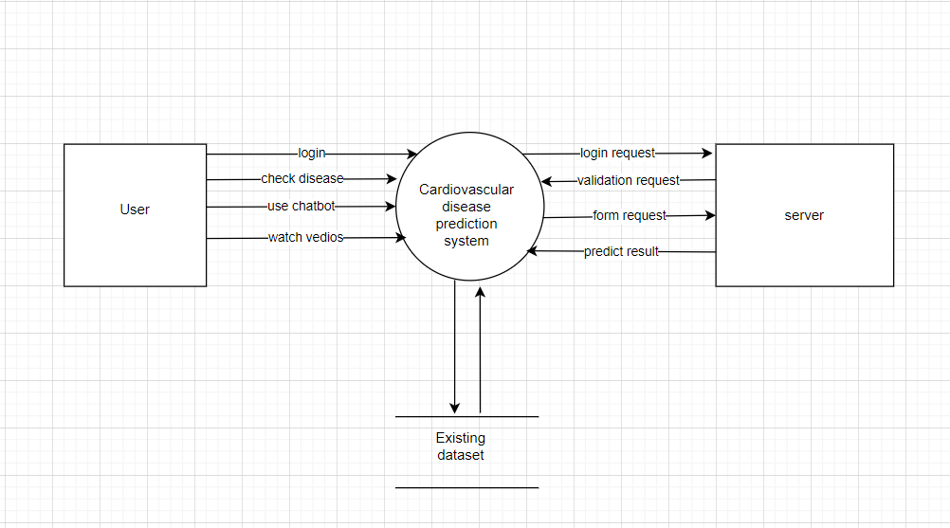
.
DFD level 0-

Slide 16
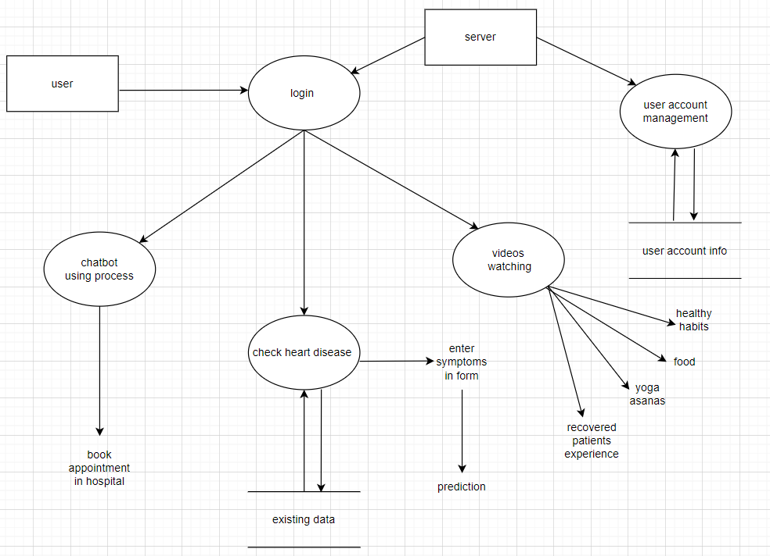
DFD level-1

Slide 17
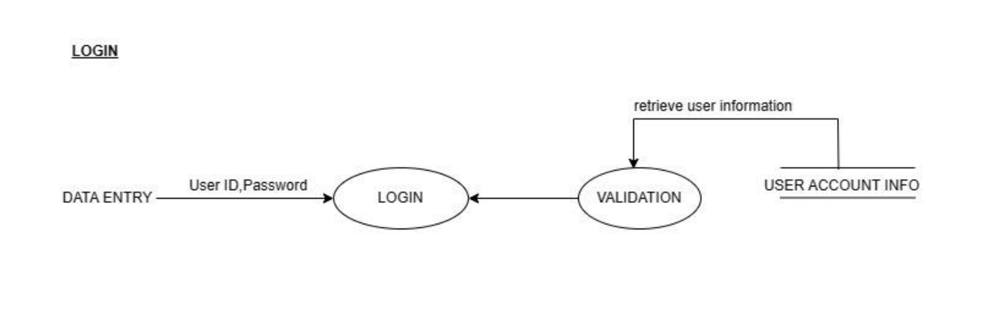
Login

Slide 18
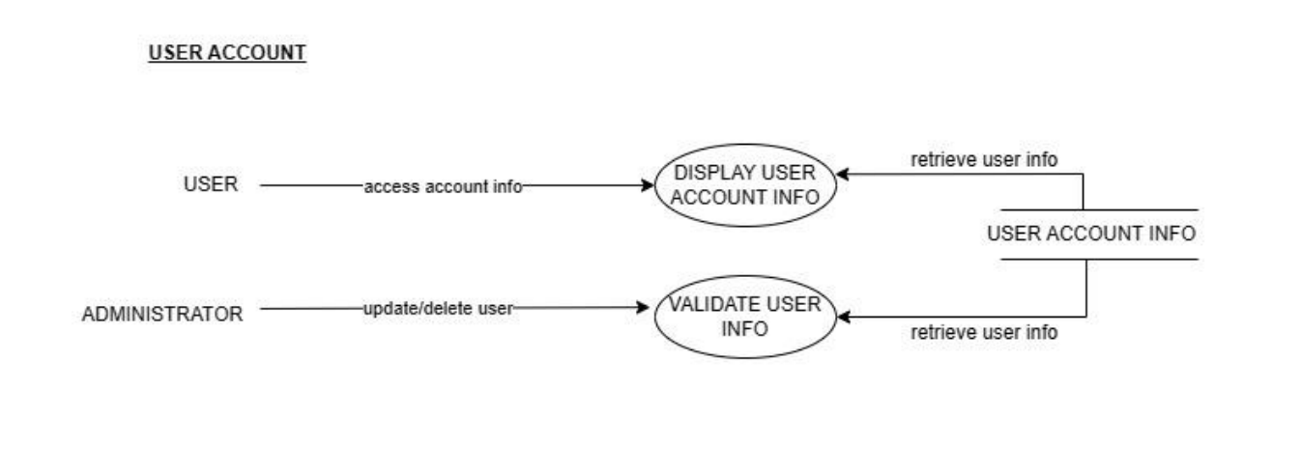
DFD level 2 User Account Management

Slide 19
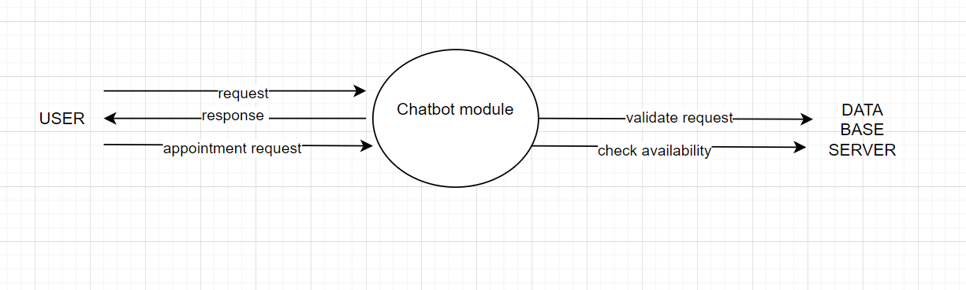
Chatbot module management

Slide 20
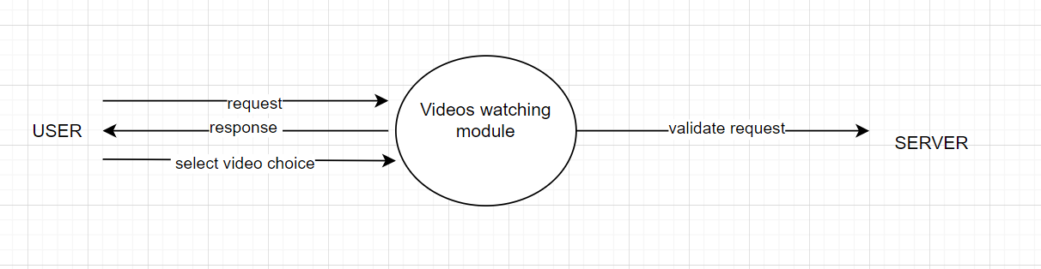
Videos module

Slide 21
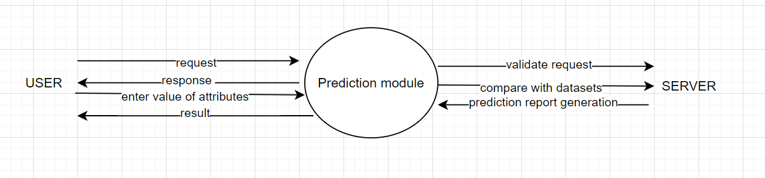
Prediction module process

Slide 22
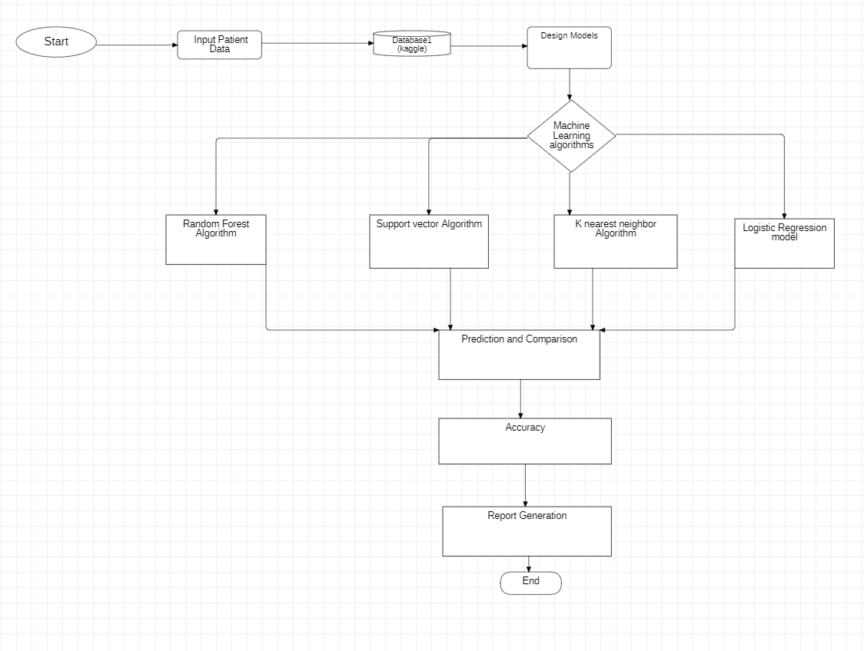
Flow Chart-

Slide 23

PROJECT OUTPUT Sign Up/Login Page

Slide 24
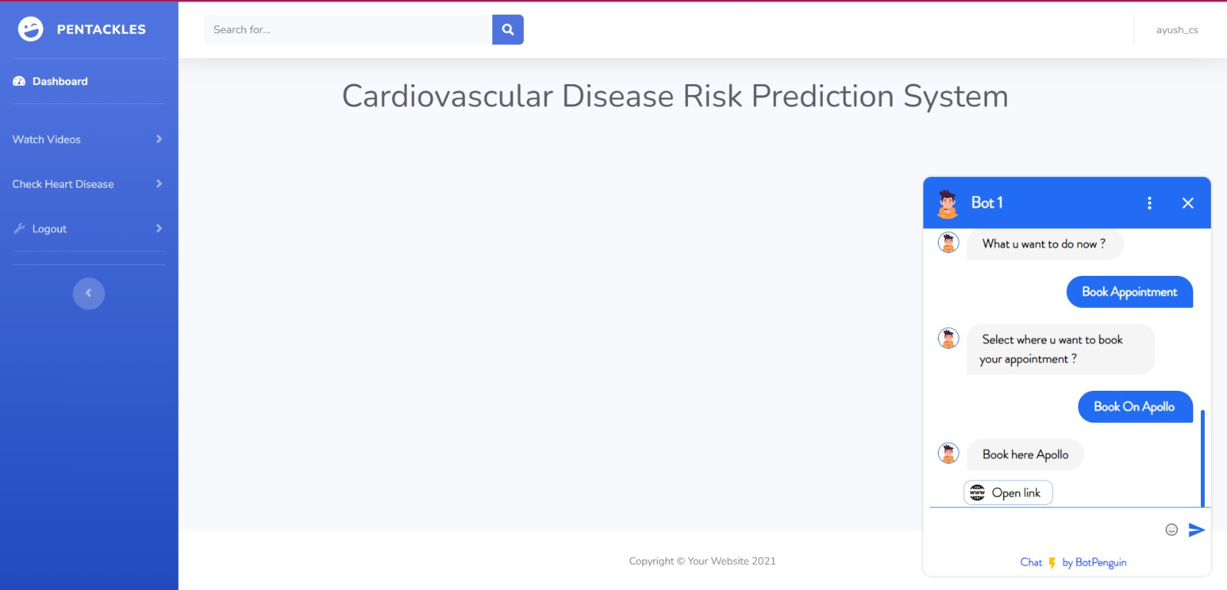
.

Slide 25

Project Status

Slide 26
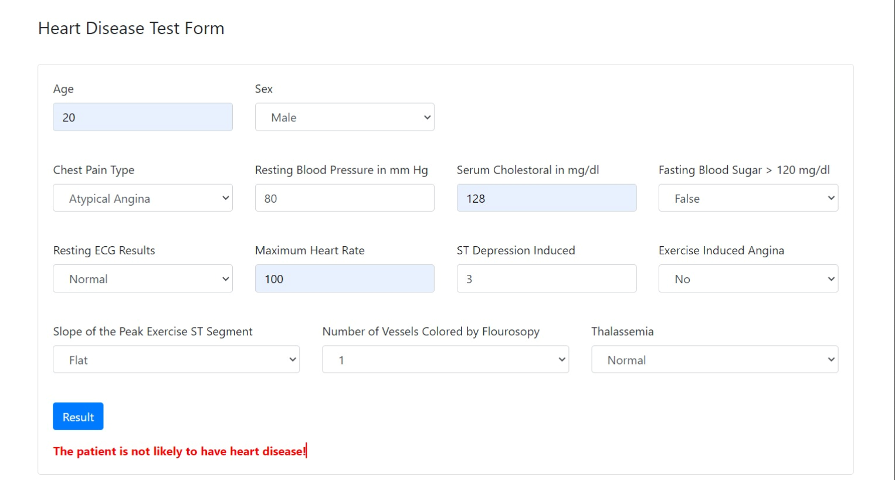
Heart Disease Predictor

Slide 27
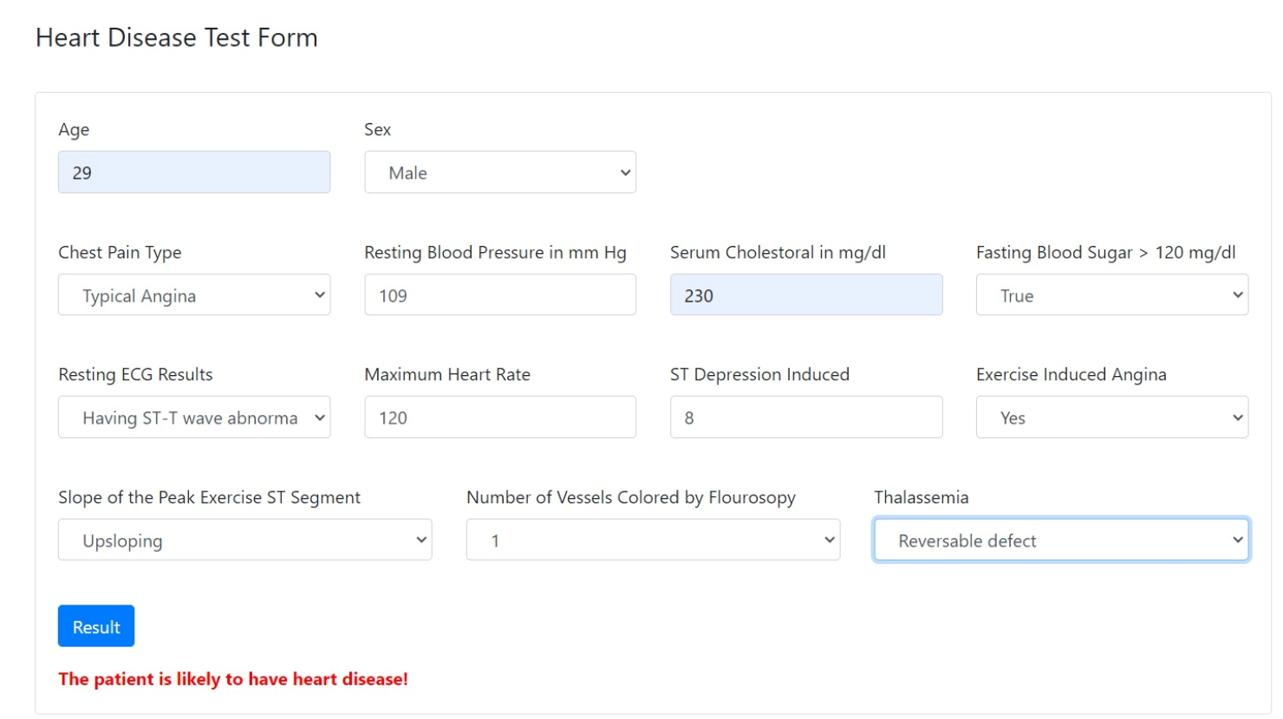
.

Slide 28
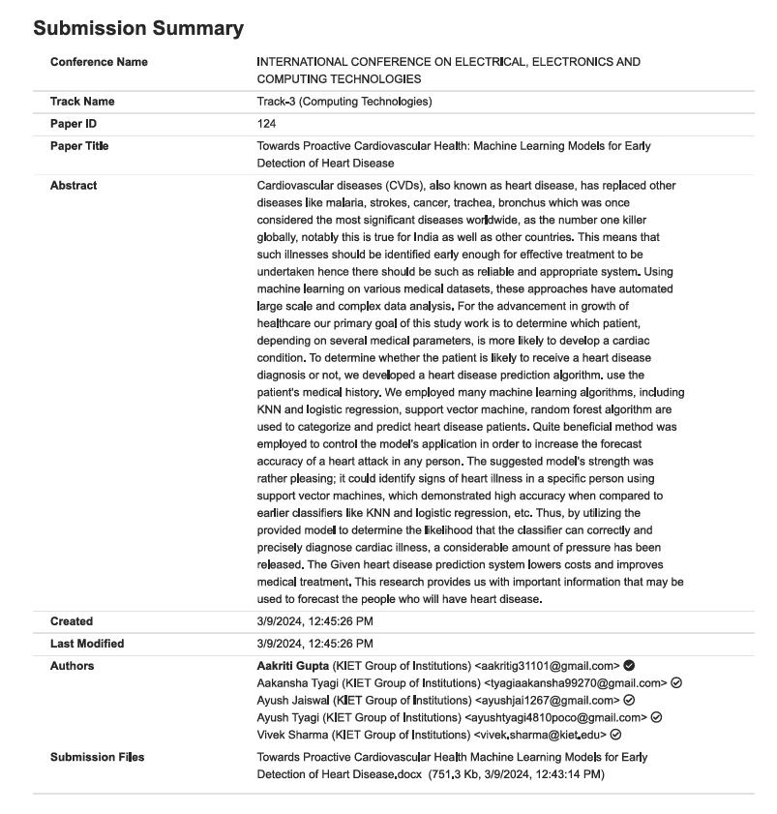
RESEARCH PAPER STATUS

Slide 29
References
[1] A. S. D. M. ,. S. Mandakini Priyadarshani Behera, "A Hybrid Machine Learning algorithm for Heart and Liver Disease Prediction Using Modified Particle Swarm Optimization with," Procedia Computer Science, 2022.
[2] M. SeYongJang, "Machine Learning Model Prediction of Mortality in Patients With and Without Heart Failure," JACC: Advances, vol. 2, 2023.
[3] A. L. P. B. P. V. R. K. Alireza Ghasemieh, "A Novel Machine Learning Model with Stacking Ensemble Learner for Predicting Emergency Readmission of Heart-Disease Patients," Decision Analytics Journal, 2023.
[4] 1. ,. Y. R. a. ,. H. Y. a. ,. Y. D. b. ,. Y. L. a. ,. Y. Y. a. ,. A. M. a. ,. T. Y. d. ,. Y. W. c. ,. F. X. c. ,. Q. H. e. Y. Z. a. Yue Huang a, "Using a machine learning-based risk prediction model to analyze the coronary artery calcification score and predict coronary heart disease and risk assessment," Computers in Biology and Medicine, 2022.
[5] C.-k. T. b. C.-J. W. b. S.-H. C. b. Y.-S. H. b. L.-J. K. b. Chun-Ling Lin a, "Title-Development of smart cardiovascular measurement system using feature selection and machine learning models for prediction of sleep deprivation, cold hands and feet, and Shanghuo syndrome," International Measurement Confederation , 2023.
[6] V. S. A.-D. b. ,. N. M. c. ,. A. A. H. d. ,. I. M. a. ,. S. A. e. ,. K. F. A.-t. f. ,. K. A. g. ,. F. M. B. g. ,. M. A. M. Md. Mamun Ali a, "Machine Learning Approach for Risk Factors Analysis and Survival Prediction of Heart Failure Patients," Healthcare Analytics, 2023.
[7] L. V. R. G. Stojanov, ": Machine Learning-Based Predictive Models for Heart Disease Diagnosis," King Saud University, 2023.
[8] S. M. P. K. P. S. M. Subasish Mohapatra, "Heart Diseases Prediction based on Stacking Classifiers Model," International Conference on Machine Learning and Data Engineering, 2023.
[9] A. C. A. R. W. E. E. Qi Li, "Automating Cardiovascular Disease Prediction Using Machine Learning and EMR Data," International Journal of Medical Informatics, 2022.
[10] R. R. N. Y. N. B. S. K. D. Khandaker Mohammad Mohi Uddin, "Machine Learning-Based Approach to the Diagnosis of Cardiovascular Disease Using a Combined Dataset," Intelligence-Based Medicine, 2023.

